Slide 1
Critical Principles for
Community Health

Slide 2
Introduction
In March 2017 nearly 400 community health champions from 44 countries, representing multiple sectors, gathered in Johannesburg to share global- and country-specific evidence and lessons and identify opportunities and challenges for institutionalizing community health as an integral component of primary health care.
These community health champions—including government officials, civil society and private sector leaders, policymakers, sub-national managers and practitioners, researchers, representatives of bilateral and multilateral organizations and donors—outlined 10 critical principles that they recommend countries focus on to accelerate progress in health.
This is the time to join forces with communities and lead the paradigm shift in health systems to save the lives of millions of children, adolescents, and women and provide an opportunity for them to thrive and transform the future.

Slide 3
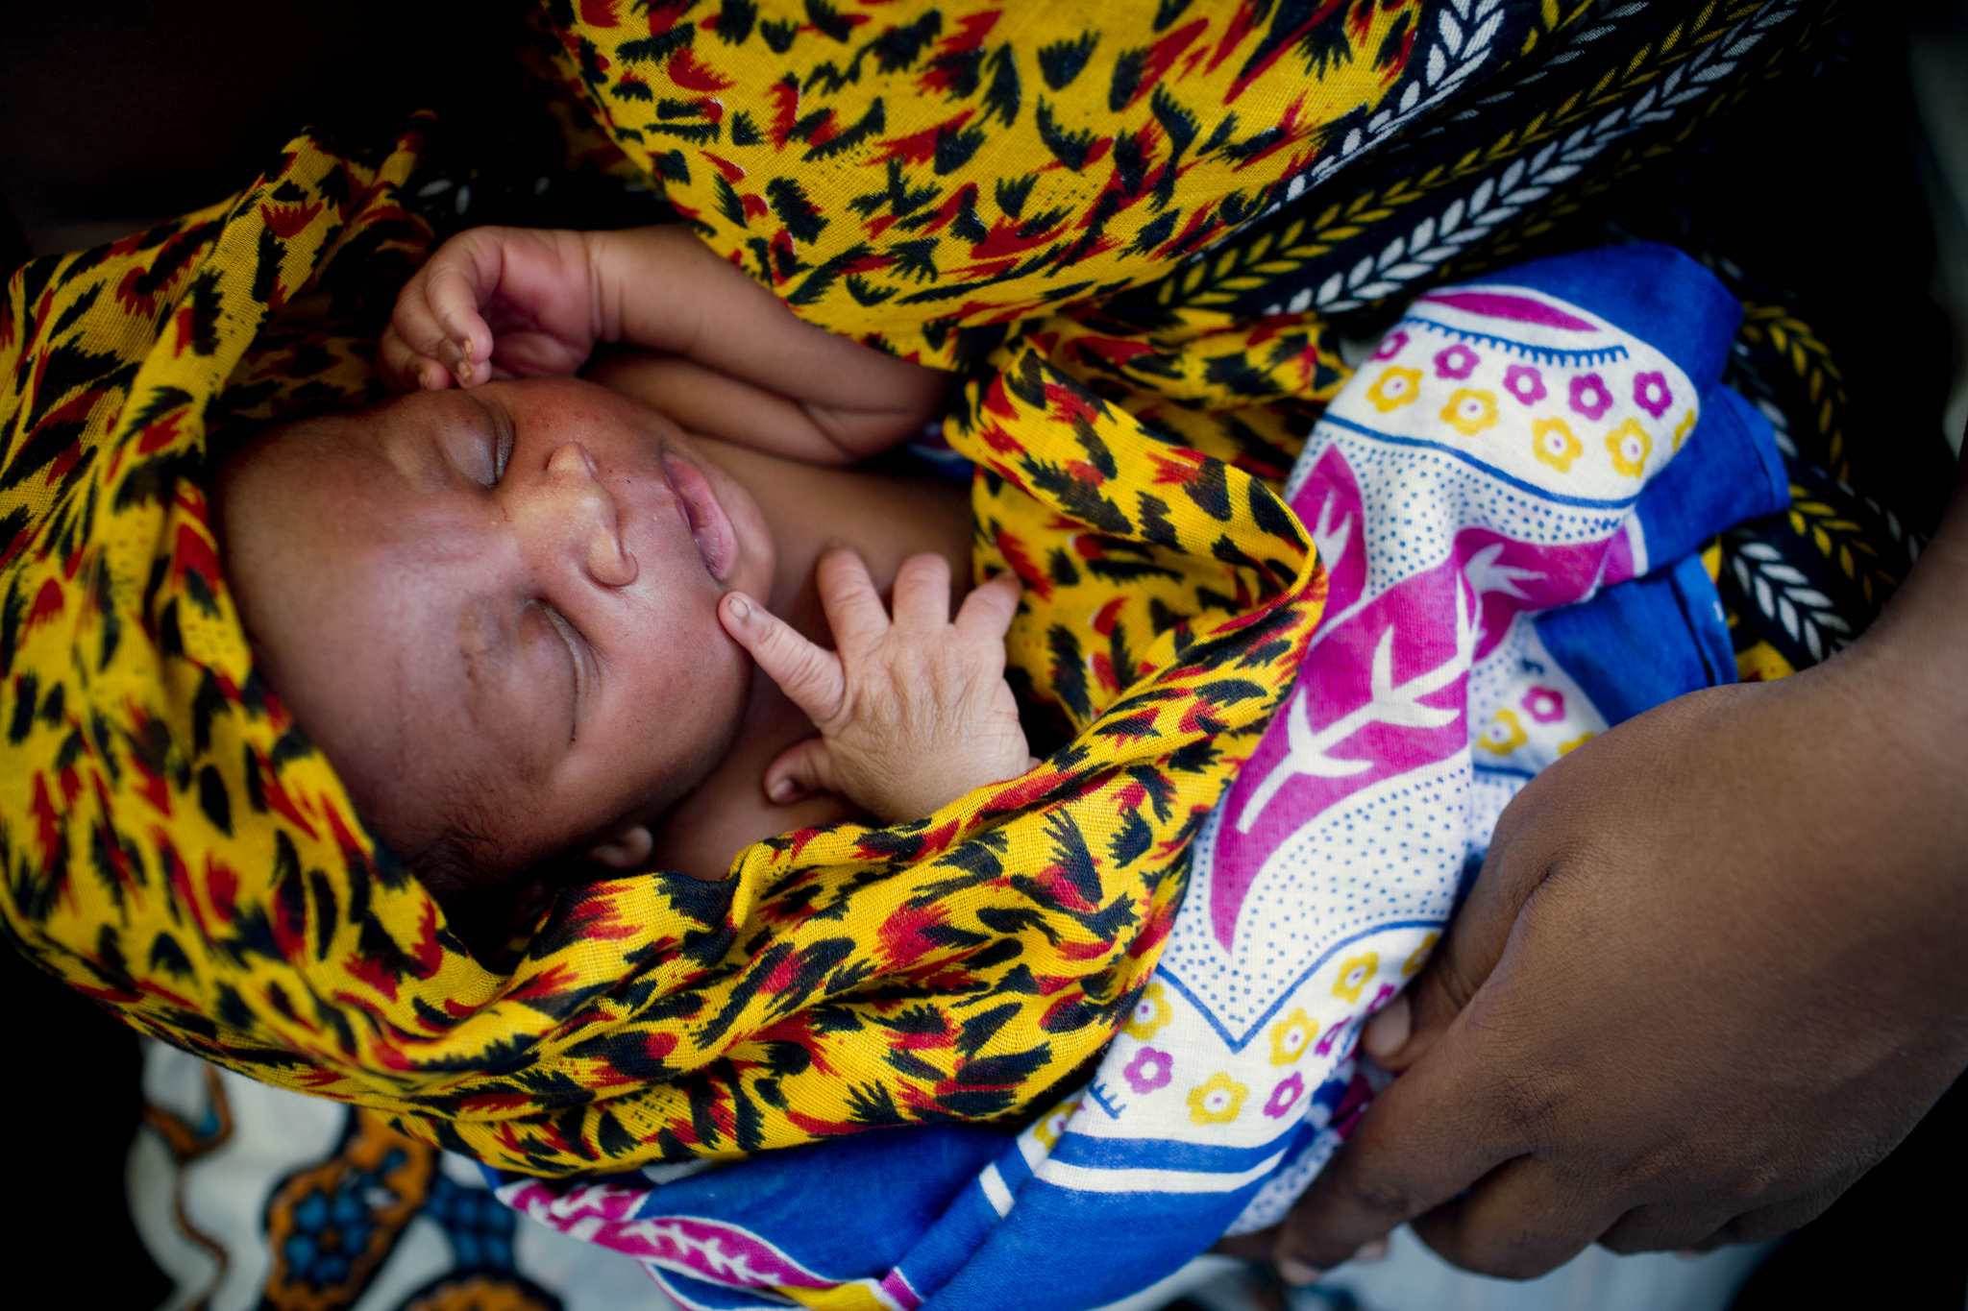
#1
Engage with and empower communities to build viable and resilient community health systems with strong links to health and other relevant sectors
GHANA
TANZANIA

Slide 4
#2
Empower communities and civil society to hold the health system accountable
RWANDA

Slide 5
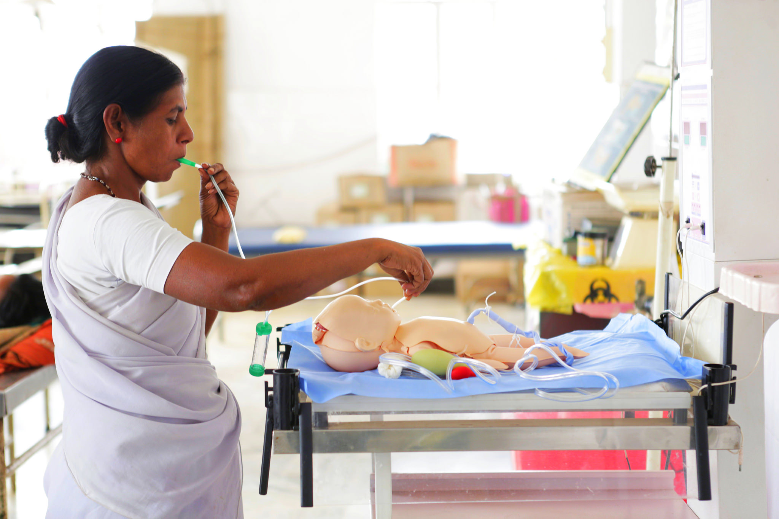
#3
Build integrated, resilient community health systems based on recognized frontline health workers
PAKISTAN

Slide 6
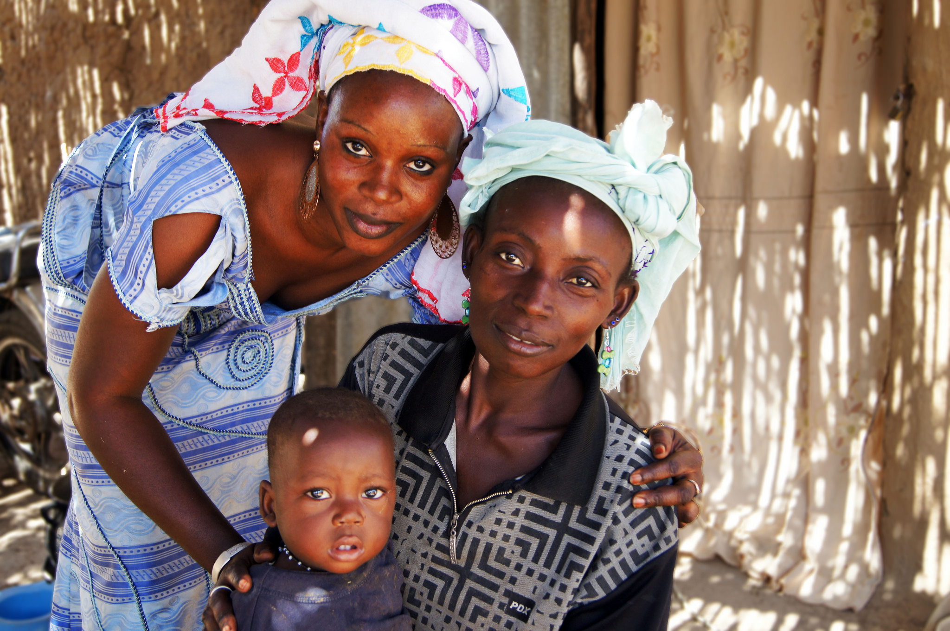
#4
Implement national community health programs at scale, guided by national policy and local systems context, to ensure impact
MALI

Slide 7
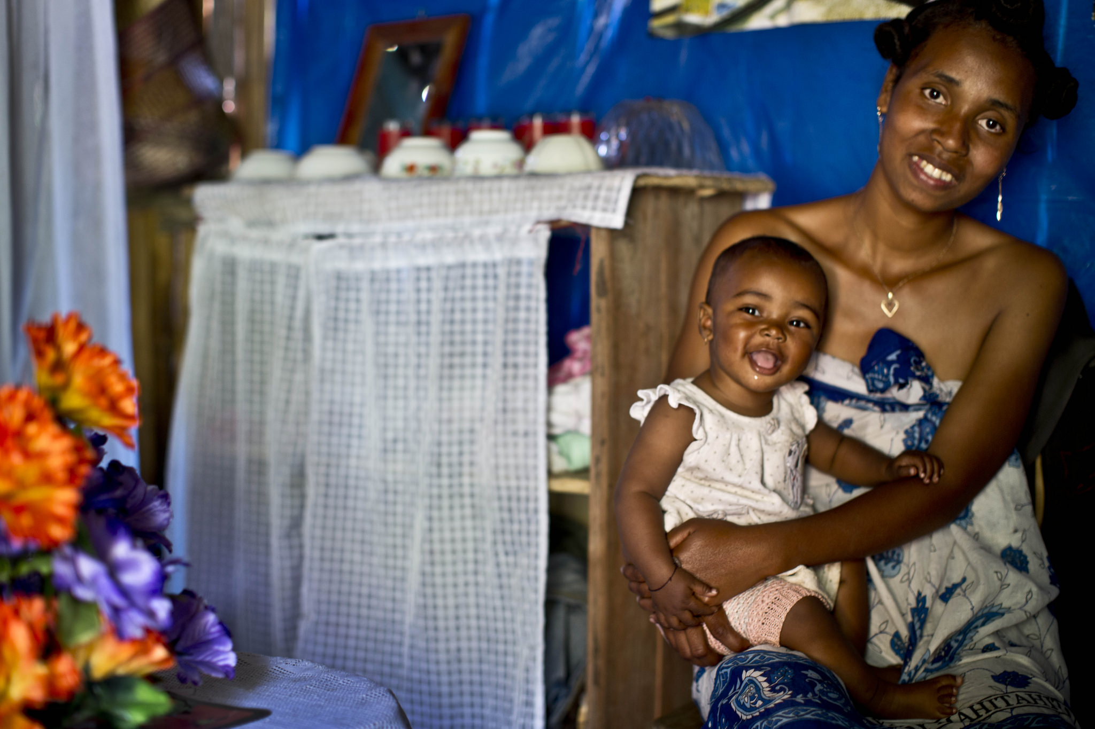
#5
Ensure sufficient and sustainable financing for community health systems that is based on national and international resources, includes the private sector, and contributes to reducing financial barriers to health
MADAGASCAR

Slide 8
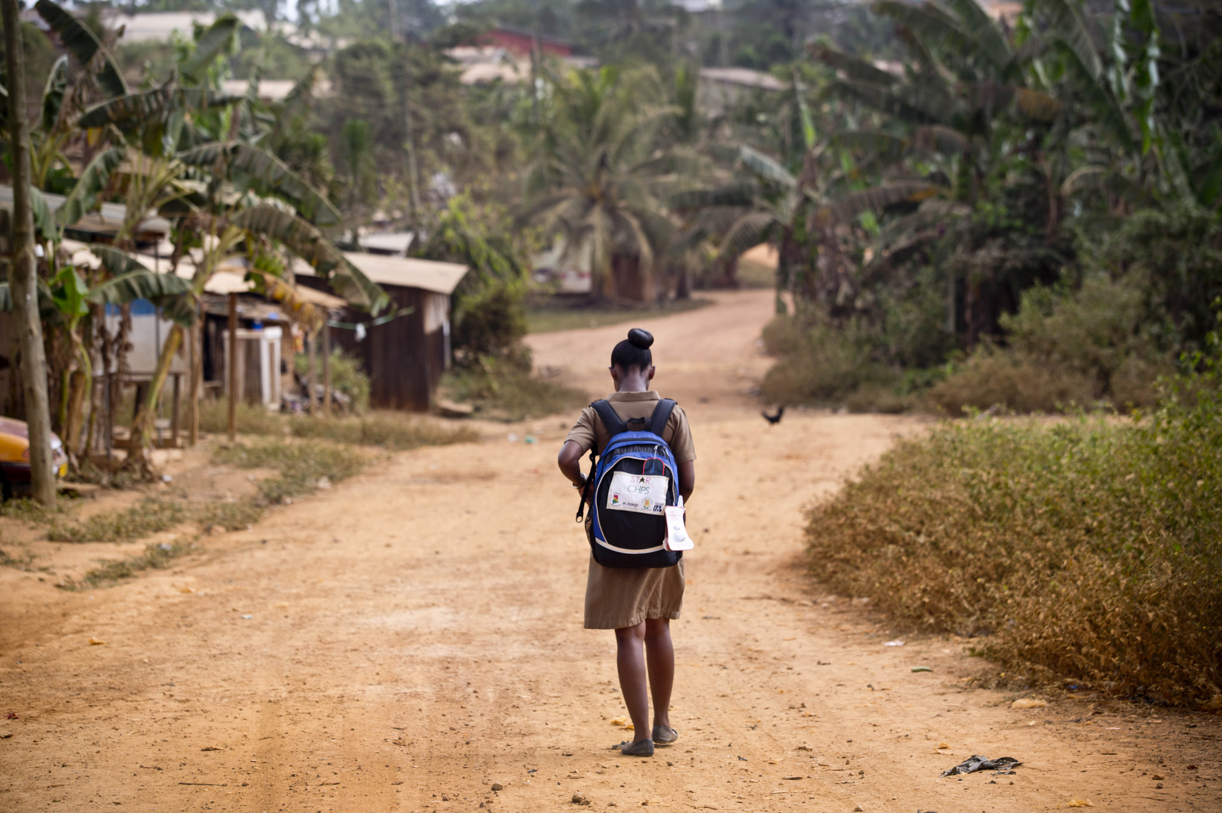
#6
Program to reduce health inequities and gender inequalities
GHANA

Slide 9
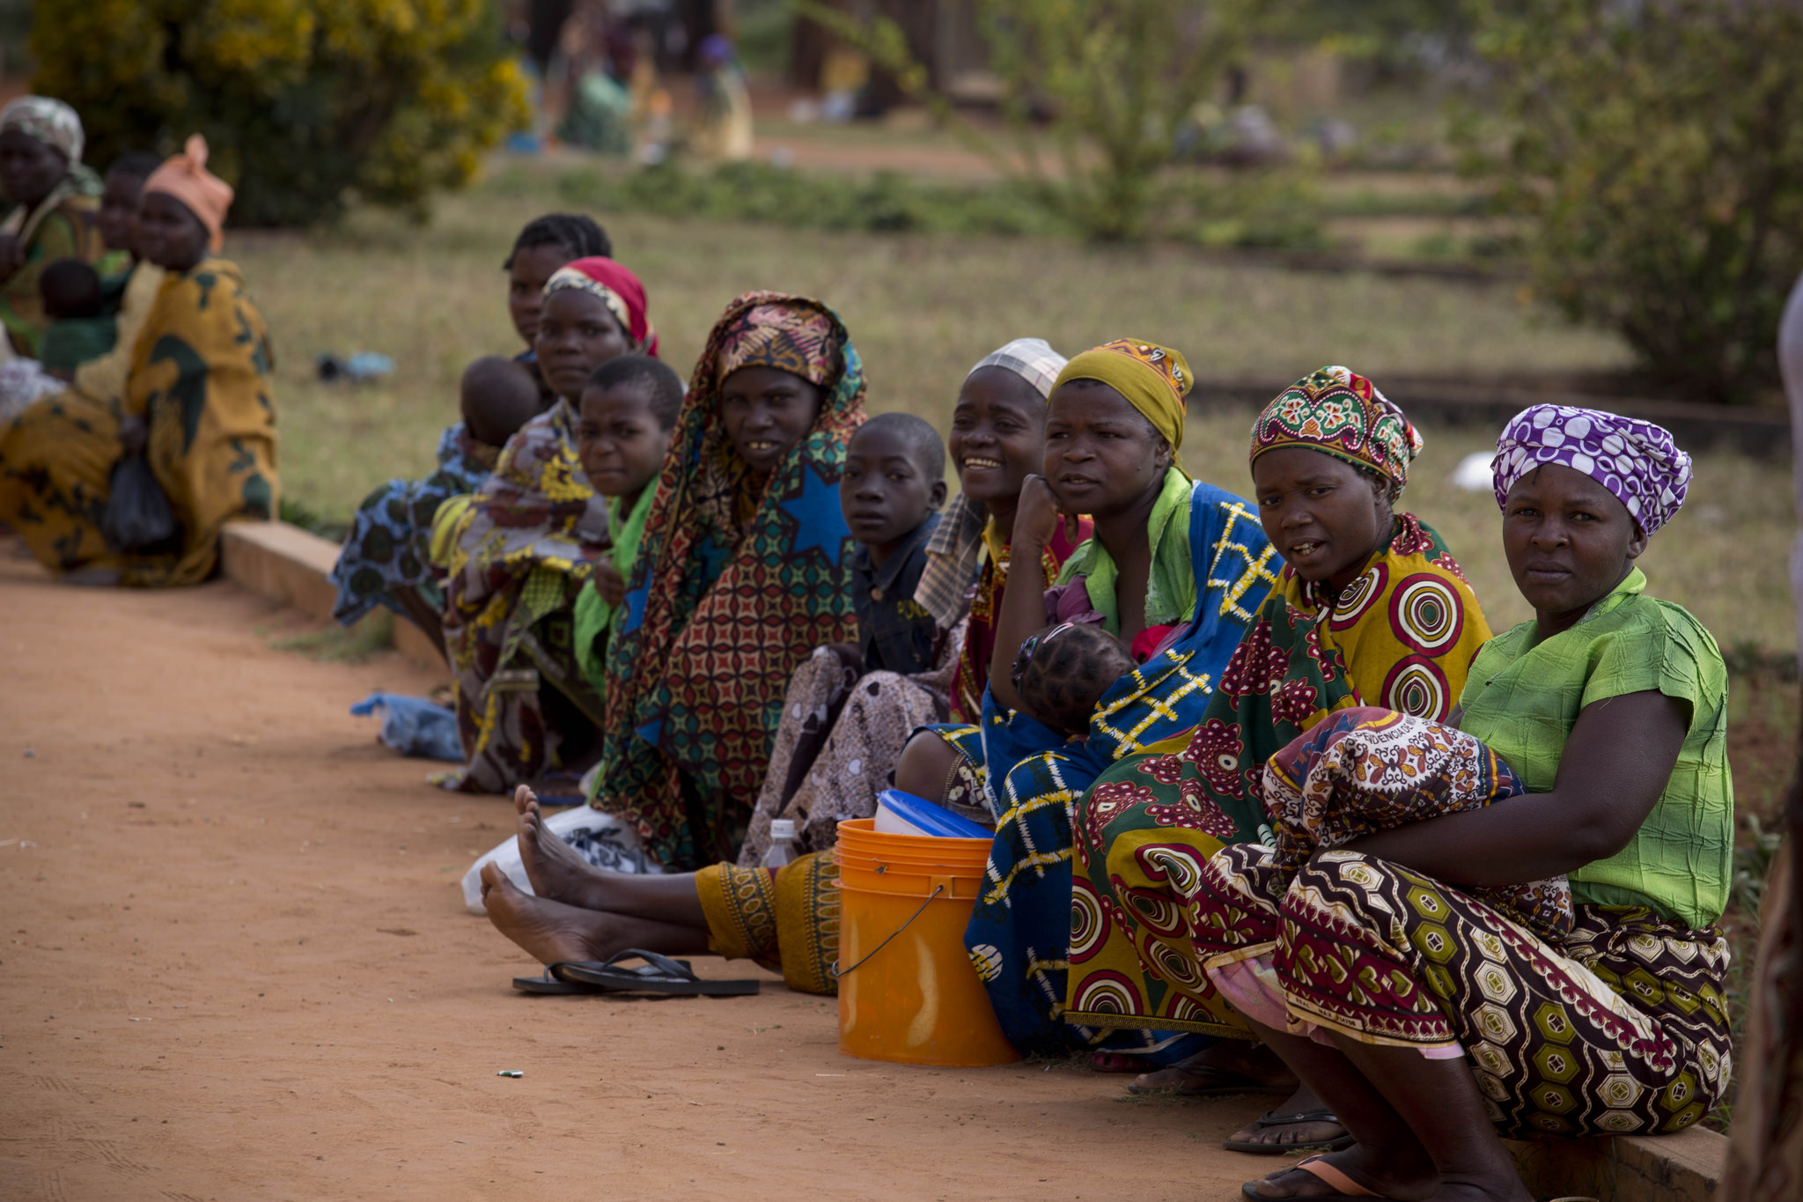
#7
Ensure that communities facing humanitarian crisis receive essential healthcare, particularly at the community level
MOZAMBIQUE

Slide 10
#8
Invest in the development of inclusive partnerships to leverage and coordinate diverse civil society and private sector actors to support national acceleration plans and enable communities to shape and support the implementation of policies
LIBERIA

Slide 11
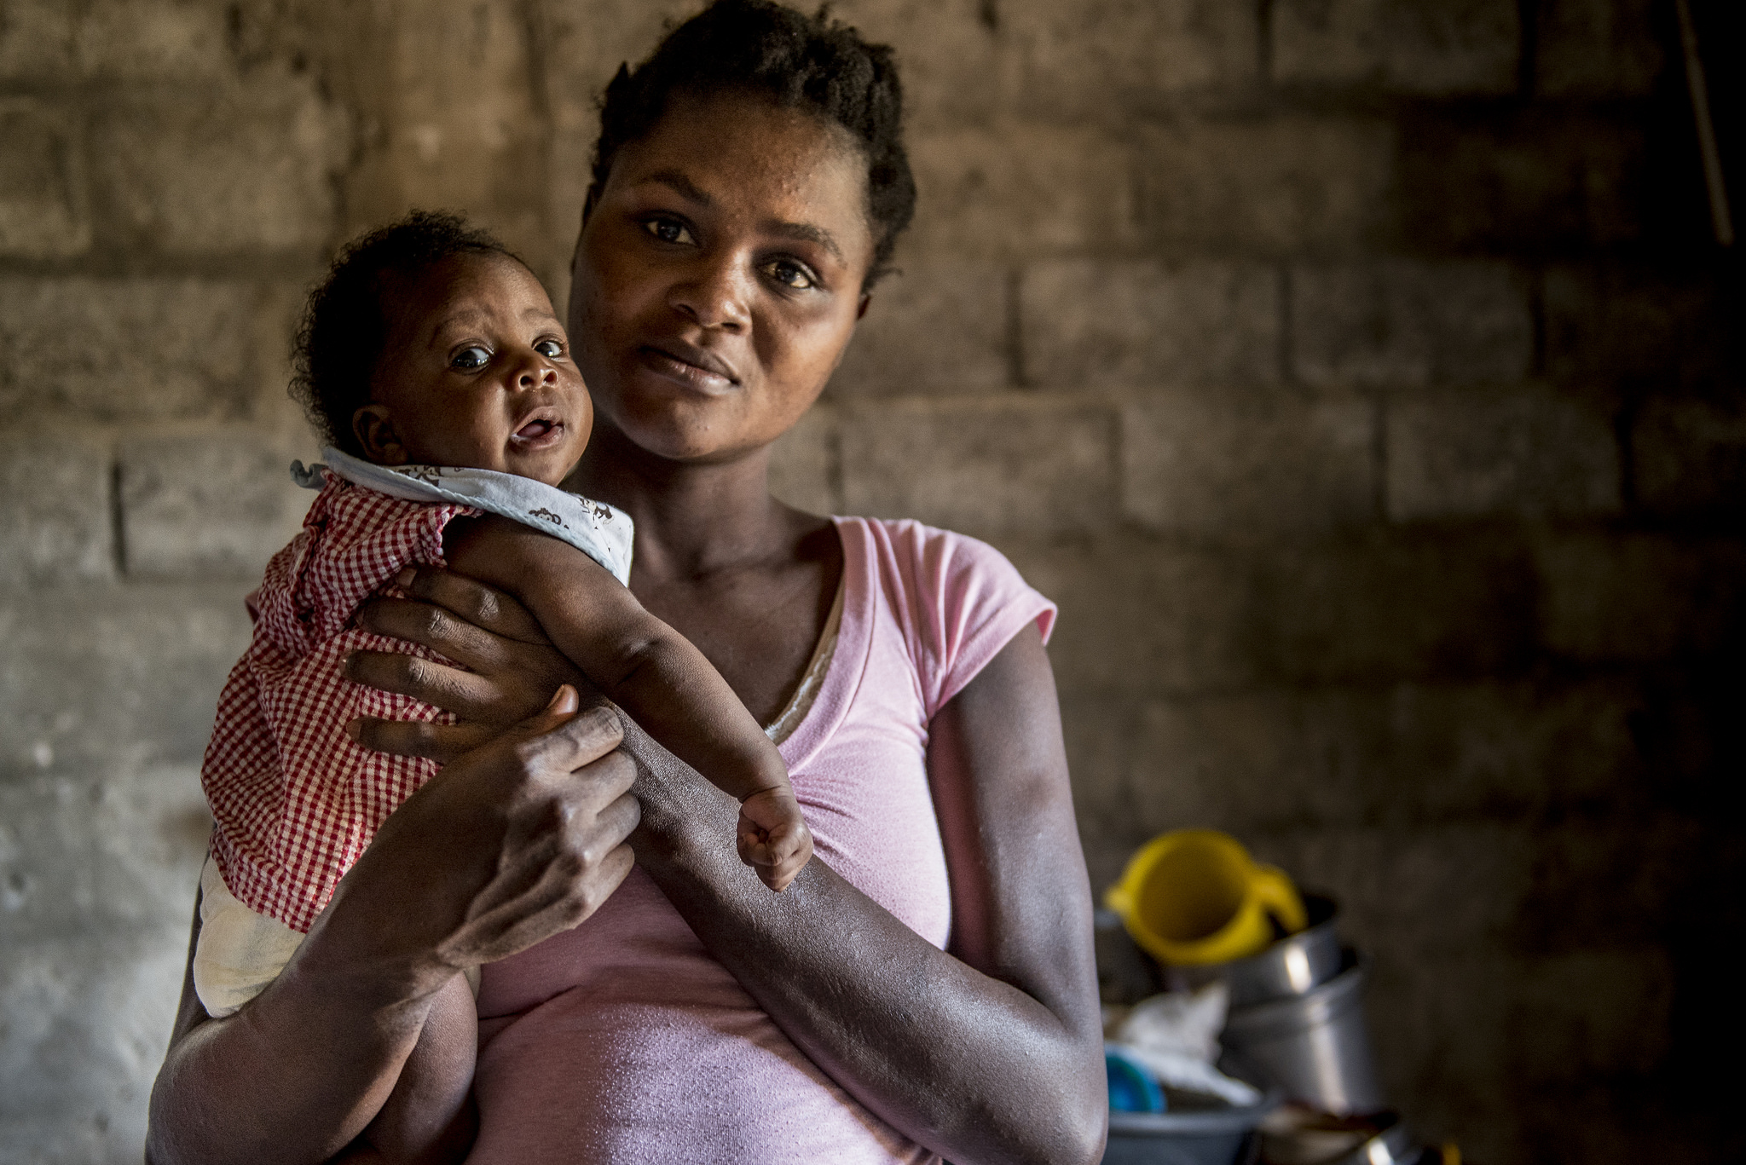
#9
Integrate community data into the health information system, including investment in innovative technologies
HAITI

Slide 12
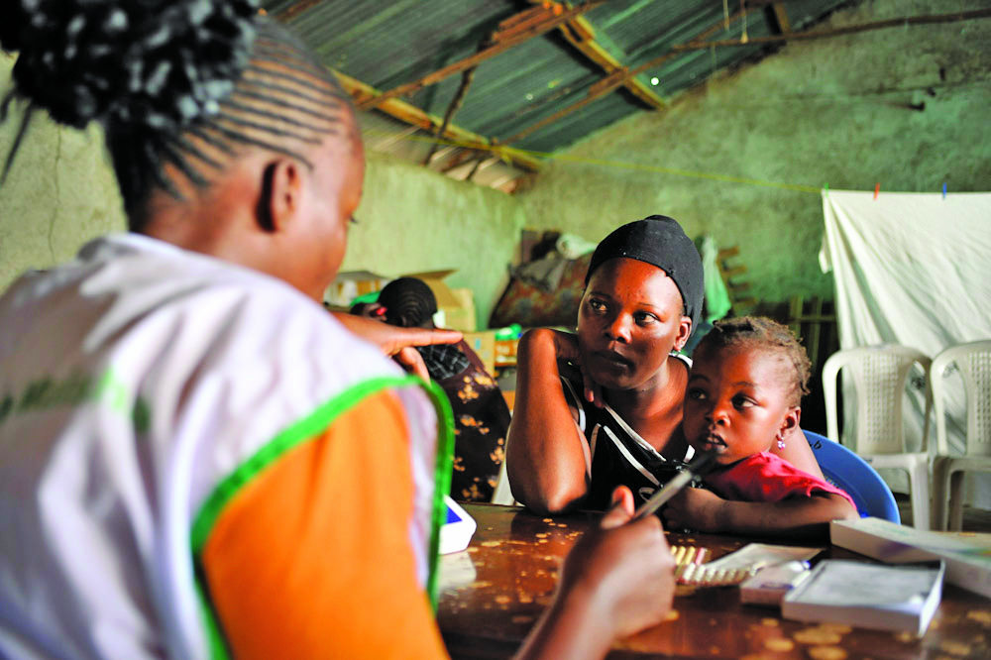
#10
Employ practical and participatory learning and research to identify, sustain, and scale up effective community interventions while providing opportunities for country-to-country lesson sharing and informing a shared global learning agenda
KENYA

Slide 13
More Information
Find the long and short versions of the principles and other information on the ICHC website: www.ichc2017.org.

Slide 14
#HealthForAll
ichc2017.org

